Slide 1


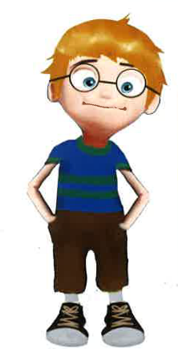
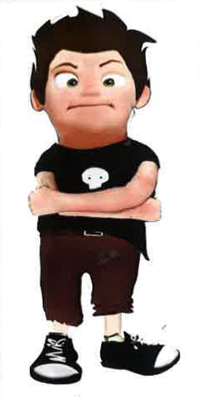
EMOTIONAL INTELLIGENCE
María Pilar García de la Torre
PhD, Senior Lecturer
Psychology Department
Faculty of Sciences Education
University of A Coruña

Slide 2
Why do we need to develop
Emotional Intelligence?
Improved problem-solving skills
More collaboration with peers.
Better impulse control.
Improvement of behaviour.
Improved interpersonal effectiveness and popularity.
Increased coping skills.
Increased ability to handle interpersonal problems.
Better control of anxiety.
Less delinquent behaviour.
Improved school performance (improved attention).

Slide 3
Ice-breaking activity
Identify the emotions felt when listening to the proposed activity
  those of oneself
  those of others
Skills used by the volunteer (analize the context, think on different options…)

Slide 4
Definition
SALOVEY AND MAYERS, 1990:
Set of skills hypothesized to contribute:
to the accurate appraisal and expression of emotion in oneself and in others (identifying and expressing),
the effective regulation of emotion in self and others (self-control), and
the use of feelings to motivate, plan, and achieve in one's life (behaviour).

Slide 5
Social skills
EMOTIONAL INTELLIGENCE
Communication styles

Slide 6
Social skills
SALOVEY AND MAYERS, 1990:
Set of skills hypothesized to contribute:
to the accurate appraisal and expression of emotion in oneself and in others (identifying and expressing),
the effective regulation of emotion in self and others (self-control), and
the use of feelings to motivate, plan, and achieve in one's life (behaviour).

Slide 7

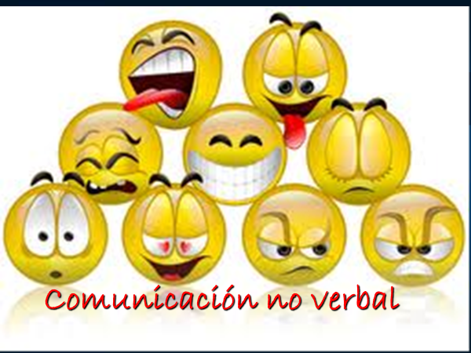
Non verbal communication

Slide 8
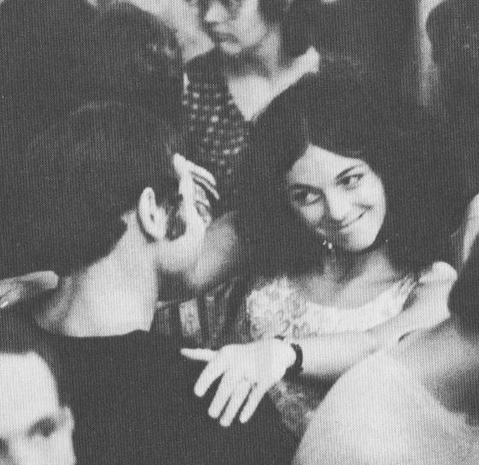

Slide 9
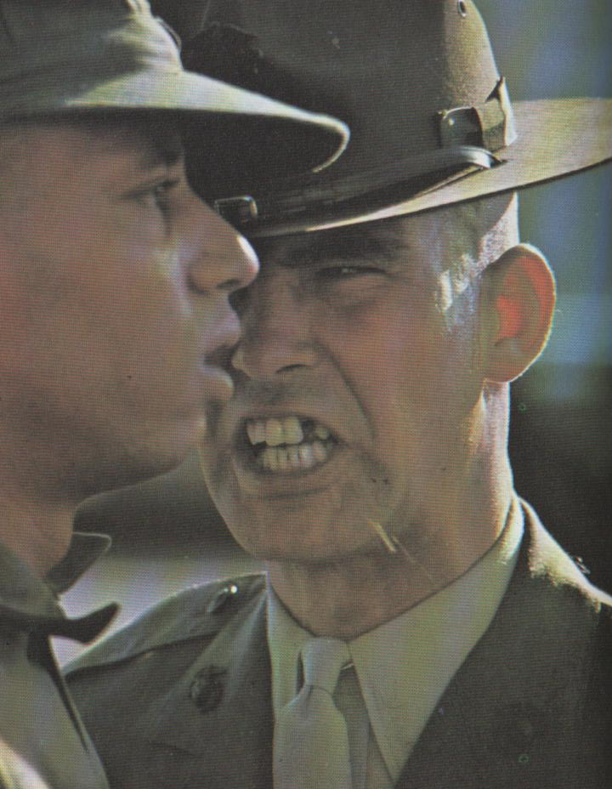

Slide 10


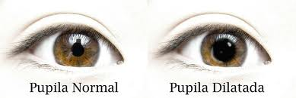
Pupillary dilatation
The pupils constrict or dilate according to the light that hits them.
They are affected by emotional changes and concentration.
They dilate when we see something of interest to us.

Slide 11
Boy
Boy and mother
Naked man
Naked woman
Landscape

Slide 12
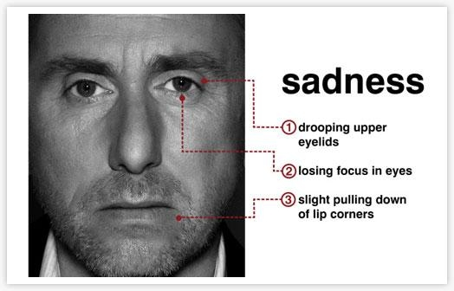
Face expressions

Slide 13
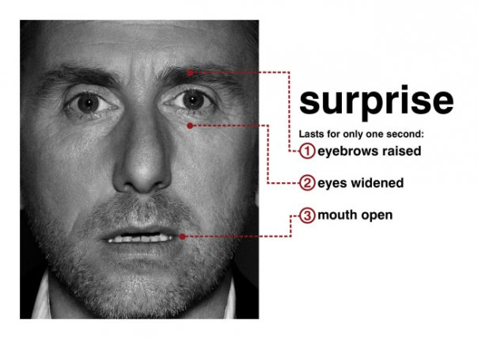
Expresiones faciales

Slide 14
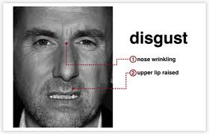
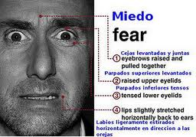

Slide 15
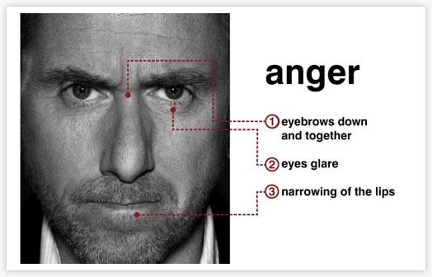

Slide 16
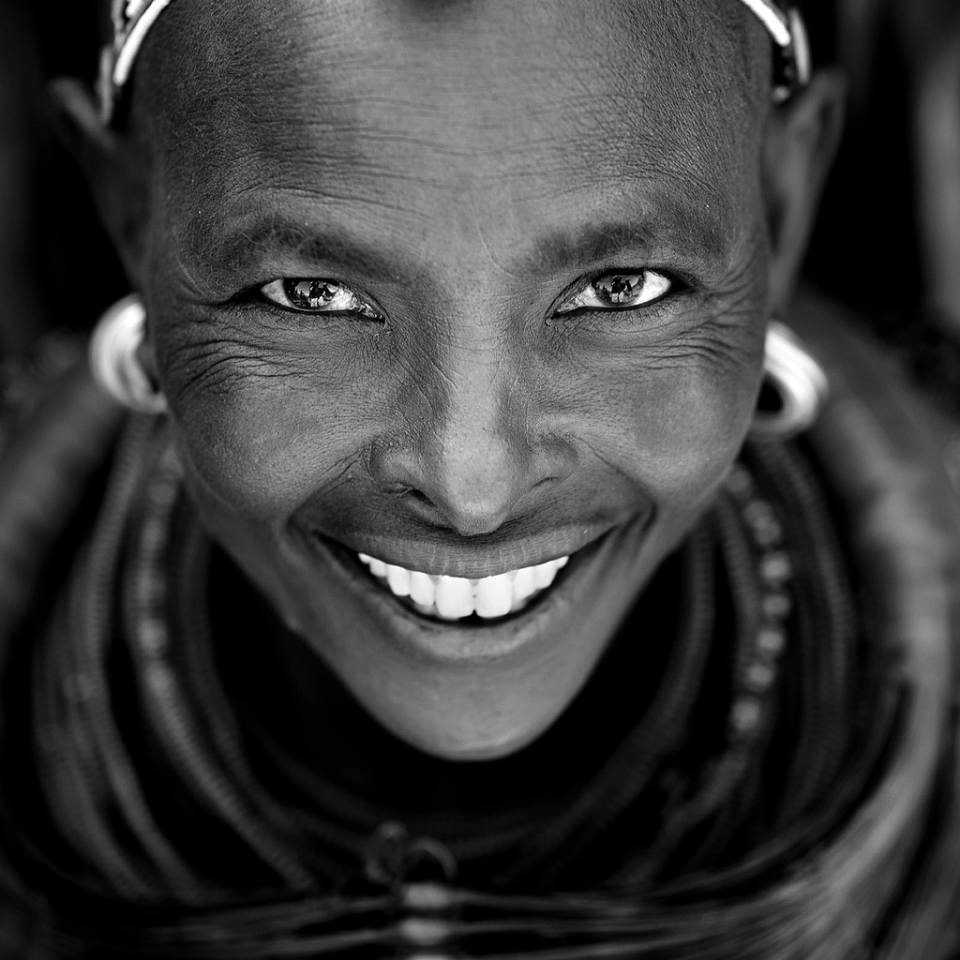

Slide 17
IMPORTANT RULE!!!!
“When an expression is adopted, the mood shifts to the emotion expressed …”

Slide 18
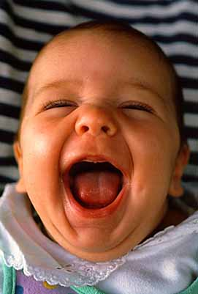

Slide 19



These ways are developed during our lifetime, according to our reactions or expressions
There are different ways to relate to each other
How messages are received depends on how you say them
Styles of
Communication
They depend on the style of communication you use
aggressive
Types
passive
(Inhibited)
assertive

Slide 20
Communication styles
Non Assertive Assertive Agressive
Non-verbal communication Non-verbal communiction Non-verbal communication
Avoiding eye contact; Eye-contact; straight posture; Too intense eye-contact;
trembling hesitation; relaxed gestures; smiling; not enough corporal distance;
head lowered, quiet voice no tension in the muscles threatening gestures.
Verbal communication Verbal communication Verbal communication
“May be”; “Perhaps”; “I think”; “I feel like”; “Do”; “You must”;
“Would you mind very much”; “Let´s do it together”; “If you don´t…”
“It doesn´t matter” “how can we solve this?” “You don´t know”
Consecuences Consecuences Consecuences
Low self-steem; conflicts; Solve problems Interpersonal conflicts
depression Are satisfied and relaxed It hurts others

Slide 21
Resources
Advancing Social and Emotional Learning - CASEL,
  SEL: What are the core competencies and key settings?
6 seconds: Emotional Intelligence network
Standing Up to Bullying: Children’s Books to Build Social and Emotional Skills

Slide 22
Resources
Maurice, E. Tobias, S. & Friedlande, B. (2000). Raising Emotionally Intelligent Teenagers. Nueva York: Harmony Books.
Patti, J. & Tobin, J. (2006). Smart School Leaders: Leading with Emotional Intelligence. Dubuque, IA: Kendall Hunt.
Salovey, P., & Mayer, J. D. (1990). Emotional Intelligence. Imagination, Cognition and Personality, 9(3), 185-211. https://doi.org/10.2190/DUGG-P24E-52WK-6CDG
Shona Anderson (2011). No More Bystanders = No More Bullies: Activating Action in Educational Professionals. Thousend Oaks: Corwin.
Zins, J., Weissberg,R., Wang, M & Walberg, H. (2007). Building Academic Success in Social and Emotional Learning: What does the Research Say? Nueva York: Teachers College Press.

