Slide 1
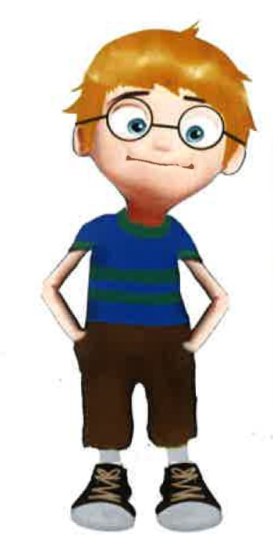
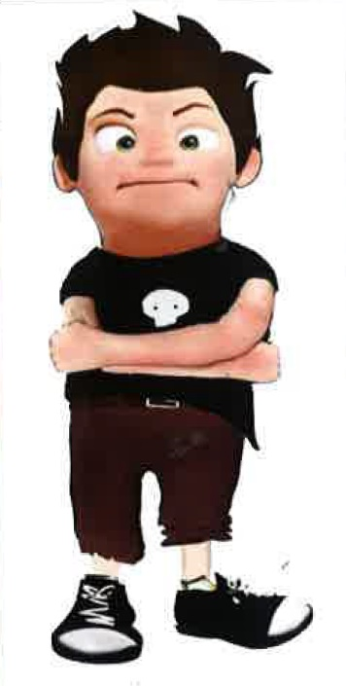

Slide 2
IDENTITY AND PEER RELATIONSHIP:
A GROUP TEEN EXPERIENCE
This Teen Experience are emotional health worskshop focusing on teenagers between 14 and 18.
A High School´s Headmasters Team wants to get some kind of action that helps the emotional health of the students and reduce anxiety levels. This kind of ideas became popular after lockdown COVID 19. This High School has a safety feminist space where this idea grew up.
The most important factors for developing a healthy emotional care are positive/confident/sensitive identity and good peer relationships.

Slide 3
IDENTITY AND PEER RELATIONSHIP:
A GROUP TEEN EXPERIENCE
OUR PROPOSAL
Work with groups of teenagers between 14 and 18.
Groups must have at least 6 people and no more than 12. Each group will have people with similar ages.
Frecuency: Once every fortnight.
Number of sessions: 6
The body of the sessions were:
• Reception/welcome.
• An experiencial and creative dynamic.
• Reflective questions about the dynamic.
• Closure.
The objectives of this action were:
• Develop skills to identify and express emotions.
• Recognize personal qualities and external supports to get a healthy life.

Slide 4
IDENTITY AND PEER RELATIONSHIP:
A GROUP TEEN EXPERIENCE
Previously
We make up two presentation sessions. One for students and another one for parents. We talk about the objectives of this action.
In the parents group, we talk about the particularities of adolescence, giving space to their concerns.
In the teens group, we experiment with a similar activity to the next workshop. At last, I am presenting you this activity and we´ll work with it.
The sessions time: one hour and a half each one.
It is explained to both groups that to participate in the workshop they have to sign a consent form. Teens over 16 will do it themselves, however, under 16 ones must have the parents authorization (due to Spanish law).
Also the presentation sessions, the high school puts up some posters, talks with the teachers and make some proposal to the students who are needed in our program.
People interested will have to contact with a teacher who will manage the groups.

Slide 5
IDENTITY AND PEER RELATIONSHIP:
A GROUP TEEN EXPERIENCE
THE STRUCTURE OF THE PROGRAM
 | CONTENT | ACTIVITY
Session 1 | Creating of the group: context clues, welcome question and collage. | Collage.
Session 2 | Security and insecurity. | Security and insecurity ballons.
Session 3 | Safety place: Identify and experiment with the safety place technique. | Safety place technique.
Session 4 | Identify people who inspire us security. | Trusted hand.
Session 5 | Our emotions. | Draw emotions.
Session 6 | Who am I and who do I want to become? Closing the group. | Lifeline. Snack: juices, chocolat and peanuts. Positive handy fan.

Slide 6
IDENTITY AND PEER RELATIONSHIP:
A GROUP TEEN EXPERIENCE
RESULTS
We have used a small satisfaction test with 4 questions:
Rate your level of satisfaction with your participation in the group from 0 to 10.
Has anything happened during your participation in the group that you consider important to highlight?
Explain in your own words positive aspects of your participation in the group.
Explain in your own words changes that you would introduce if you participate in the group again.
During these 3 years of experience, all the ratings have been 9 and 10.
Dropout rate: 20%

Slide 7
IDENTITY AND PEER RELATIONSHIP:
A GROUP TEEN EXPERIENCE
ARGUMENT
It was difficult do more than 6 sessions.
Actually, we don´t know if this program reduces anxiety levels, because the final test is about satisfaction.
When we work with a program like ours, some teenagers who could need it don´t go to the sessions.

Slide 8
IDENTITY AND PEER RELATIONSHIP:
A GROUP TEEN EXPERIENCE
TASKS
Play dough art.
Relaxing technique

