Slide 1
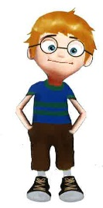
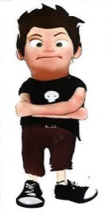
A look to the emotional self-management of bullying
Sara Fernández Basanta
PhD, MSc, BSN. Assistant Professor/Lecturer
Qualitative Research lab in Health Sciences, GRINCAR (LiCS-GRINCAR)
Health Sciences Department
Faculty of Nursing and Podiatry, University of A Coruña
Notes:
Hi, My name is Sara and I participate in the ERASMUS+ BAM project work team. Next I will present the activity "A look to the emotional self-management of bullying", which we will work on during your stay in Spain.

Slide 2
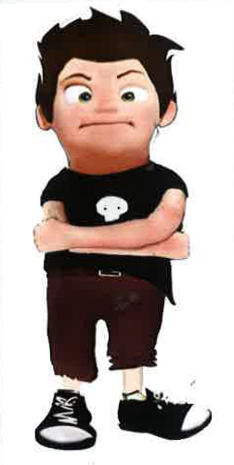
Purposes
To know what the emotional management of primary and secondary education teachers from different cultural contexts is like with respect to addressing bullying
To know what an educational experience has meant for these teachers in terms of their role and emotional management of bullying.
Notes:
This activity, using the photovoice methodology, has two main objectives:

Slide 3
Study Procedures
Initial photovoice
Discussion group
Final photovoice
Before your arrival in Spain
During your stay in Spain
After finishing your stay in Spain
Notes:
To do this, if you decide to participate in this project, you will be asked for these 3 interventions in 3 three different moments

Slide 4
Study Procedures
Initial photovoice
What is the initial photovoice?
1)
2)
3)
4)
How do you feel in a bullying situation?
How do you perceive your actions in a bullying situation?
How do you think you emotionally manage a bullying situation?
Notes:
What is the initial photovoice?
Before your arrival in Spain, you will be asked to take a photograph focused or oriented around one or more of these three questions that you can see in more depth in the instructions document. The photograph can be taken with any device (camera or mobile phone) and must represent or be inspired by the proposed themes.

Slide 5
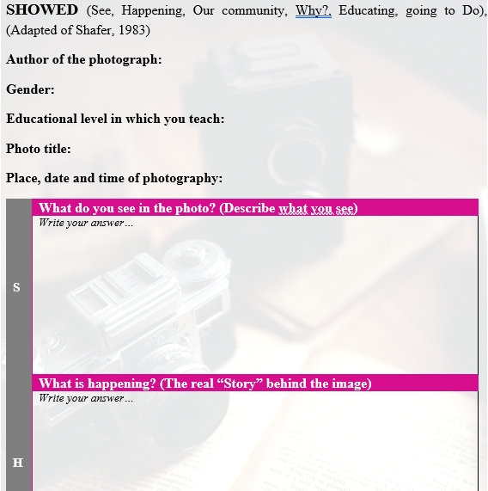
Study Procedures
Initial photovoice
What is the initial photovoice?
1)
2)
3)
4)
Notes:
Moreover, you will be asked to respond to a series of questions that will allow you to explain the photograph taken.

Slide 6
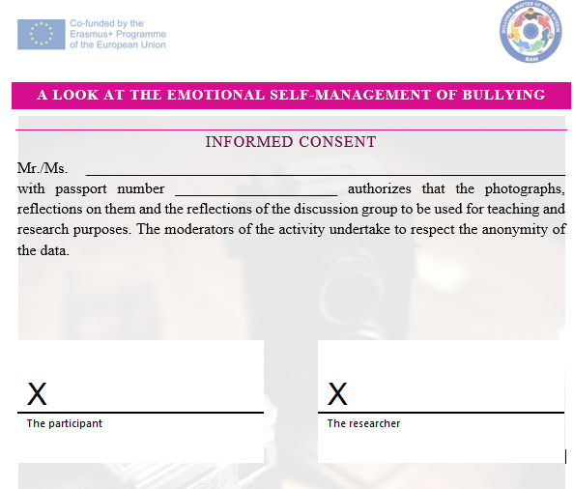
Study Procedures
Initial photovoice
What is the initial photovoice?
1)
2)
3)
4)
Notes:
In another document your consent will be requested for the photographs and reflections may be used for teaching and research purposes

Slide 7
Study Procedures
Initial photovoice
What is the initial photovoice?
1)
2)
3)
4)
Notes:
The instructions document details the information to send the photograph and the reflection, and the informed consent document.

Slide 8
Your decision to participate in this study is strictly voluntary
Put your creativity to play!

